Slide 1
Chapter 6 - Constructing Hypotheses
authored by Stephanie Fleischer © SAGE publications Ltd 2014

Slide 2
Topics covered
Definition of a hypothesis
Function of hypothesis
How to formulate a hypothesis
Types of hypotheses
Errors in testing hypotheses
authored by Stephanie Fleischer © SAGE publications Ltd 2014

Slide 3
Definition of a hypothesis
Verification of an assumption/ assertion
Assertions become the basis of the enquiry and are called hypotheses
Hypotheses bring focus to the research problem in quantitative research
Grinnell’s definition (1988: 200)
A tentative proposition that can be proven or disproven
Validity is unknown, hence reliable and valid data needed
Specifies a relationship between variables
authored by Stephanie Fleischer © SAGE publications Ltd 2014

Slide 4
Functions of a hypothesis
The formulation of a hypothesis brings specificity and clarity to a study.
This specificity and clarity used to construct a hypothesis ensures that only information needed is collected, thereby, providing focus to the study. This also enhances the validity of a study as it ensures measuring what the study sets out to measure.
As it provides a focus, the construction of a hypothesis enhances objectivity in a study.
The testing of a hypothesis enables the researcher to specifically conclude what is true or what is false, thereby, contributing towards theory formulation.
authored by Stephanie Fleischer © SAGE publications Ltd 2014

Slide 5
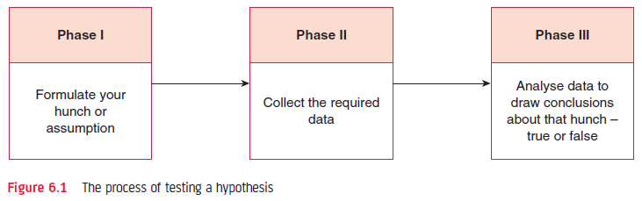
Figure 6.1 The process of testing a hypothesis
authored by Stephanie Fleischer © SAGE publications Ltd 2014

Slide 6
How to formulate a hypothesis
A hypothesis should be simple, specific and conceptually clear
A hypothesis should be capable of verification
A hypothesis should be related to the existing body of knowledge
A hypothesis should be measurable
The average age of male students in this class is higher than that of the female students.
authored by Stephanie Fleischer © SAGE publications Ltd 2014

Slide 7
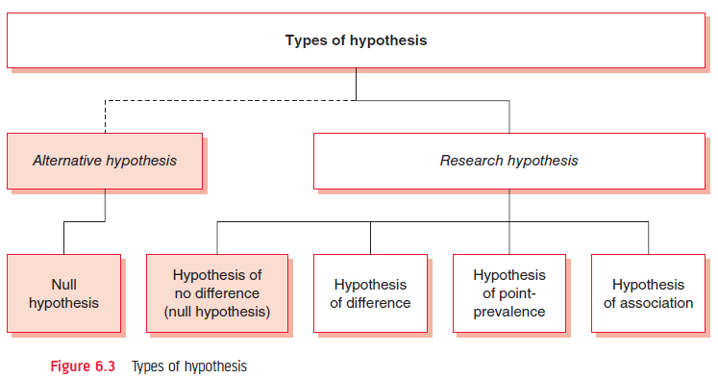
Figure 6.3 Types of hypotheses
authored by Stephanie Fleischer © SAGE publications Ltd 2014

Slide 8
Null hypothesis H₀
The null hypothesis states that there is no difference between two situations, groups, outcomes, or the prevalence of a condition or phenomenon
H₀: There is no difference in the average age of male and female students in this class
Hypothesis of difference: There is a difference in the average age of male and female students in this class
authored by Stephanie Fleischer © SAGE publications Ltd 2014

Slide 9
Errors in testing hypotheses
Incorrect conclusions about the validity of a hypothesis may be drawn if:
the study design selected is faulty
the sampling procedure adopted is faulty
the method of data collection is inaccurate
the analysis is wrong
the statistical procedures applied are inappropriate
the conclusions drawn are incorrect
authored by Stephanie Fleischer © SAGE publications Ltd 2014

Slide 10
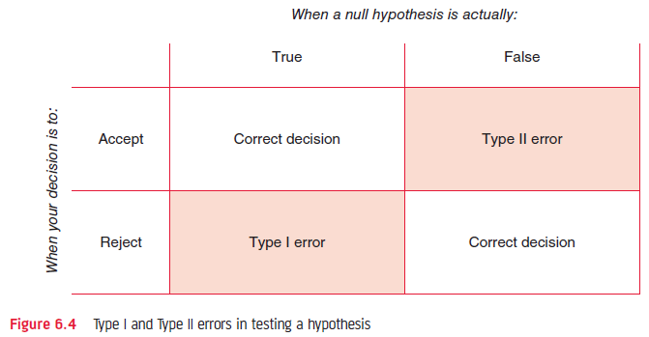
Figure 6.4 Type I and Type II errors in testing a hypothesis
authored by Stephanie Fleischer © SAGE publications Ltd 2014

